Slide 1
COMP1071 - Digital Electronics
Transistors (extra material)
Ioannis Ivrissimtzis
email: ioannis.ivrissimtzis@durham.ac.uk
Room: MCS 2023
Slide acknowledgements: Eleni Akrida and Farshad Arvin

Slide 2
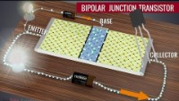
Transistors
MOS transistors are built from semiconductor material, usually silicon.
Silicon is a poor conductor of electricity: all the available electrons (4) are used to form bonds with neighbouring atoms.
Impurities (dopants) provide extra electrons or electron-holes which increase conductivity.
As: Arsenic
B: Boron
2

Slide 3
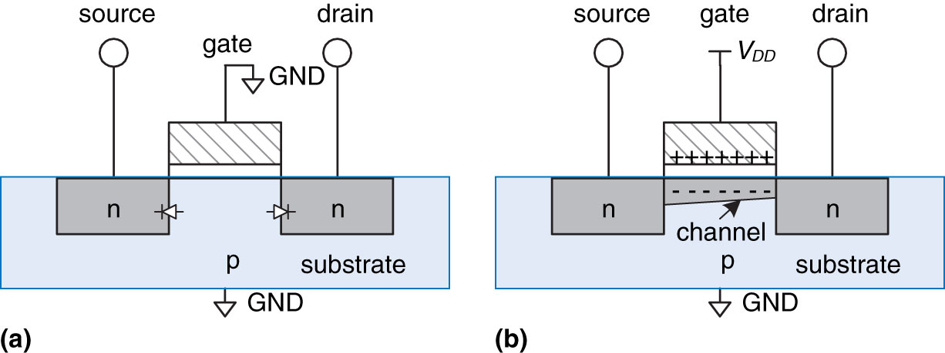
Transistors
nMOS transistor:
The MOS (Metal-Oxide-Semiconductor) is a sandwich of layers of conducting and insulating material. The gate is a conducting layer, on top of insulating layer (silicon dioxide), on top of the substrate which is semiconductor.
3

Slide 4
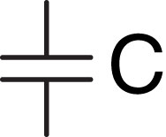
Transistors
The metal-oxide-semiconductor ‘sandwich’ is a capacitor: two pieces of conductive material separated by an insulator.
If a positive voltage is applied to one side,
it accumulates charge Q and the other side
accumulates the opposite charge -Q.
It takes time and energy to charge
or discharge a capacitor.
4

Slide 5
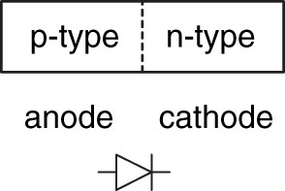
Transistors
The junction between p-type and n-type silicon is a diode.
Current can only flow from p-type to n-type.
5

Slide 6
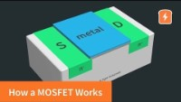
Transistors
nMOS transistor:
When the gate g is at 0V, the diode effect between n-type and p-type silicon prevents current flowing from source to drain.
6

Slide 7
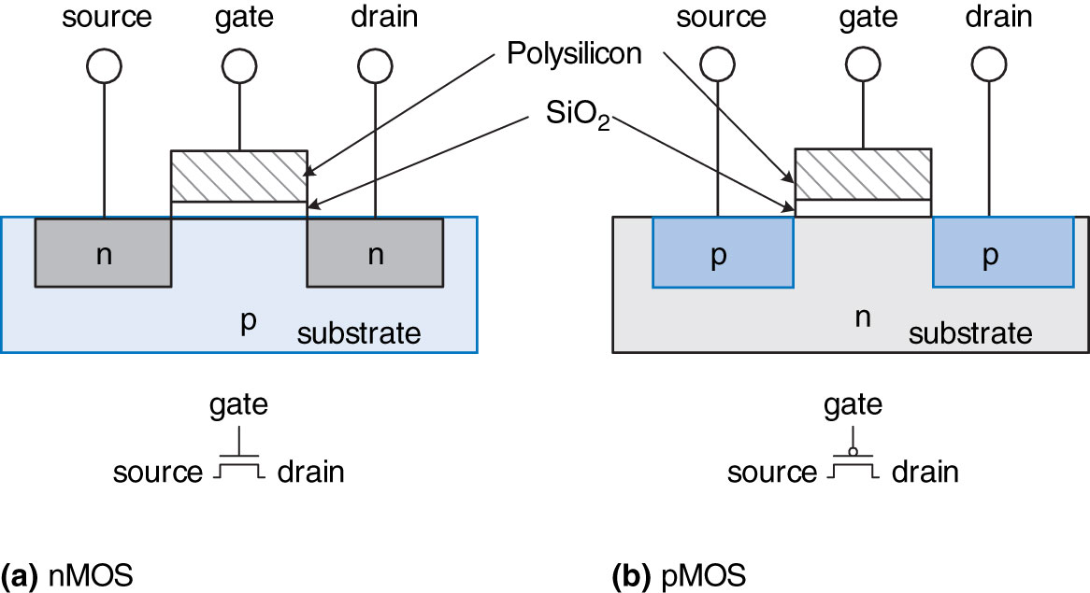
Transistors
A pMOS transistor is the opposite: on at g low and off at g high.
7

